Slide 2
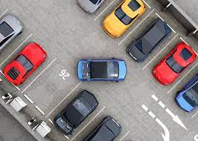
Abstract
In the rapidly evolving landscape of urban mobility, efficient management of parking spaces has become a critical challenge. This abstract introduces an innovative solution: an online car parking system designed to streamline and optimize the parking process. Leveraging cutting-edge technology, the system offers real-time availability information, allowing users to locate and reserve parking spaces remotely. Integration with mobile platforms ensures seamless user experience, while automated payment systems enhance convenience. The system not only addresses the current parking woes but also contributes to a smarter and more connected urban infrastructure. This abstract provides a glimpse into the future of parking management, where digital solutions redefine convenience and efficiency in urban transportation.

Slide 3
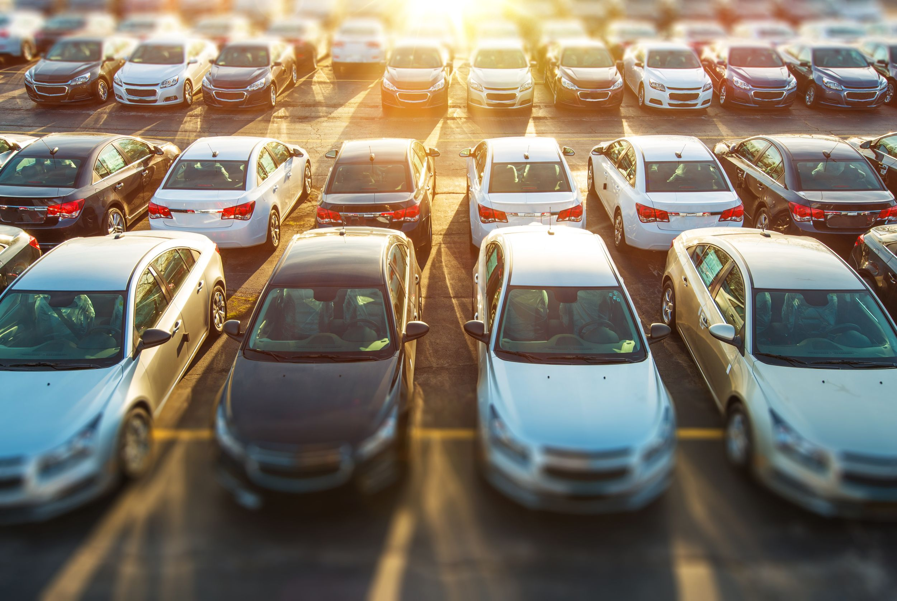
Introduction
This Web Application mainly deals with the parking slots in the buildings like clubs, hotels, malls and many more. In this Web Application we can access the information of parking slots in the building where is free. By finding the empty space the user is able to block the slot. This application also provides information about the user like Car No, License No. and mobile number the administration will able to notify the user if there is any problem. After selecting the empty space in the parking slot the user is able to pay the amount and confirm his/her booking.

Slide 4
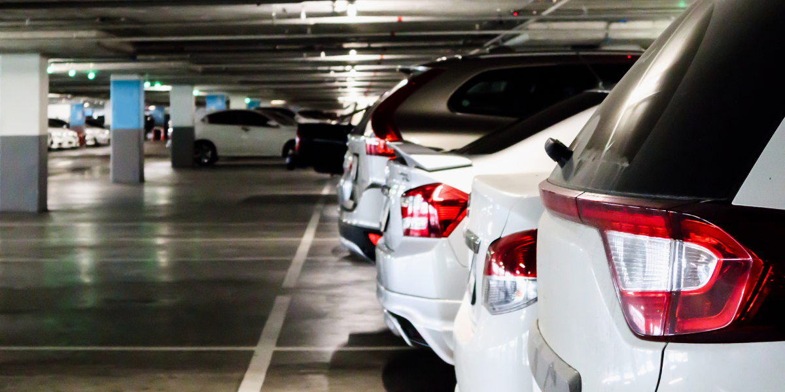
Purpose of object
The purpose of this project is to ease the process of parking through the web application. In this we mainly concentrate on parking slot in the building and the user is able to block the slot before entering into the building. The web application is designed for client side. It contains only user level.

Slide 5
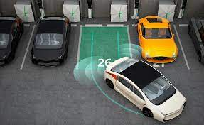
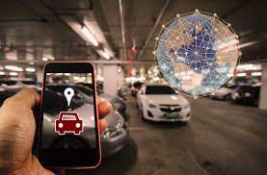
Scope of project
A detailed study of the existing system is necessary.
The functions of the system, requirements for the users, structure of the current system is made through the system study. The problems faced in the current system are found and solution pertaining to it is done in the system study.

Slide 6
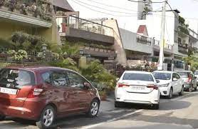
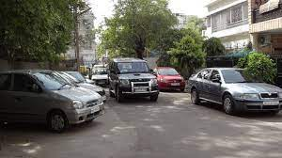
PROBLEM DEFINITION
1. Business Scenario:
Now–a– days in all the cities in India face severe parking problems. Off street parking is common in all Organizations, big shopping malls and theatres and huge offices which are used by employees & customers, on the other hand on-street parking is traffic problem causing as the parking is directly controlled by market forces, with individual parking and hence has high demand.

Slide 7
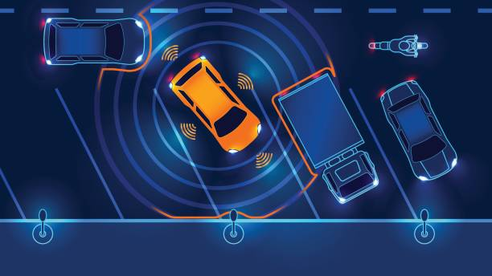
2. Existing System:
We already have many Car Parking management systems which can provide services for the users only with the help of RFID tags or Sensors. In the Existing System, by using the electrical equipment only we can find the empty slot by an indication method. We can only identify the free slot but we can't book the slot before.
Limitations in Existing System:
The following are the disadvantages of the existing system
It is difficult to maintain the whole database (images of the parking space).
Users have to spend 1-2 minutes for booking the slot (only registered).

Slide 8
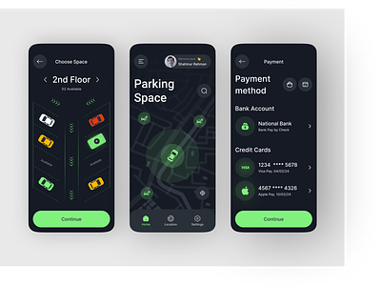
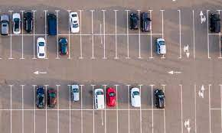
3. Proposed System:
Our web application contains a continuous list of free slots, the user can select any of the slots and can able to book the slot. After entering in to the building the user will have an option to see route/path to selected slot only if the database has map. The functionalities of the car parking system can be automated.

Slide 9
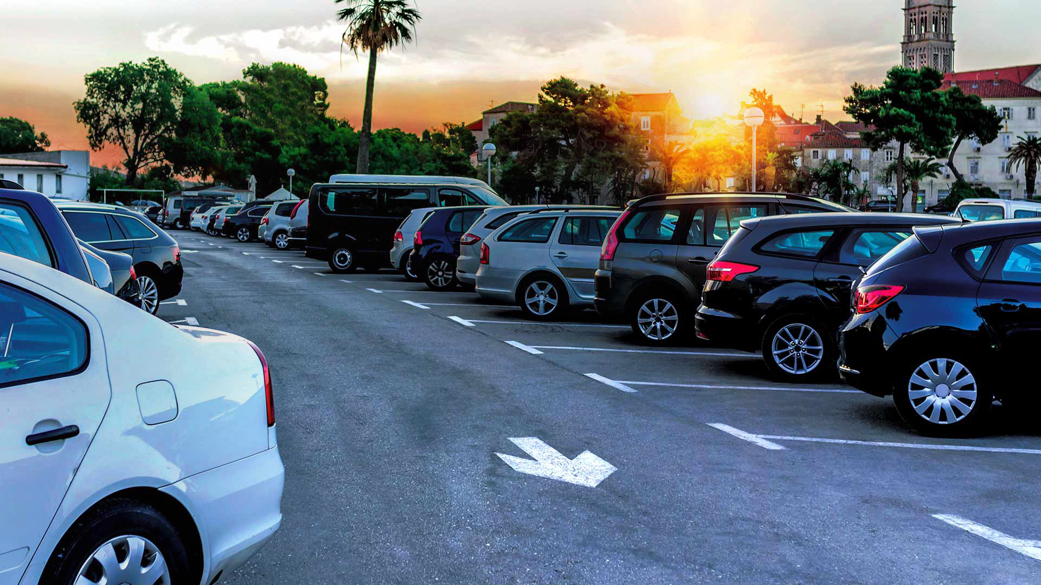
Advantages:
A fast and efficient service to the user regarding to the
Searching process is an easy task.
Selecting and booking a slot is also an easy process.
Saves lot of time while searching a free slot in the
building and even may avoid the minor accidents.

Slide 10
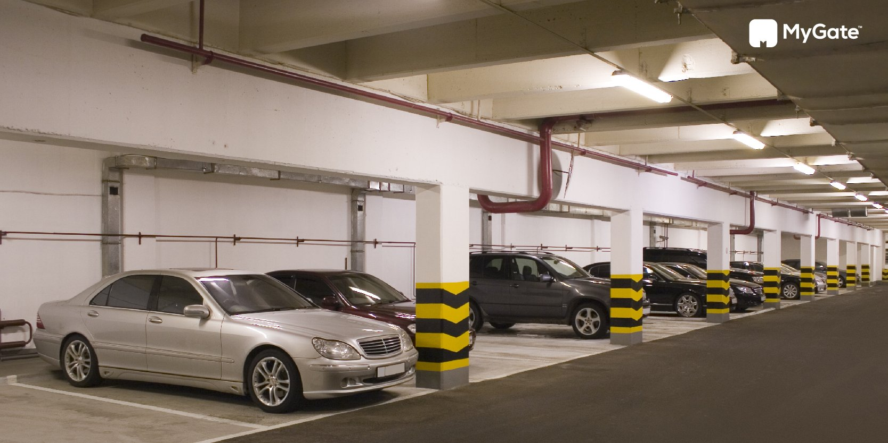
FEASIBILITY STUDy
The next step in analysis is to verify the feasibility of the proposed system. “All projects are feasible given unlimited resources and infinite time“. But in reality both resources and time are scarce. Project should confirm to time bounce and should be optimal in there consumption of resources. These places a constant are approval of any project.
Feasibility has applied to OnlineCarParkingReservationSystem pertains to the following areas:
Technical feasibility
Operational feasibility
Economical feasibilty

Slide 11
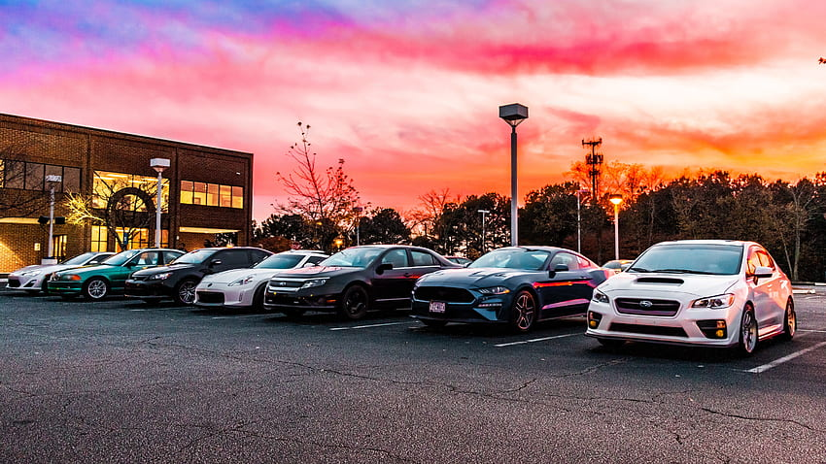
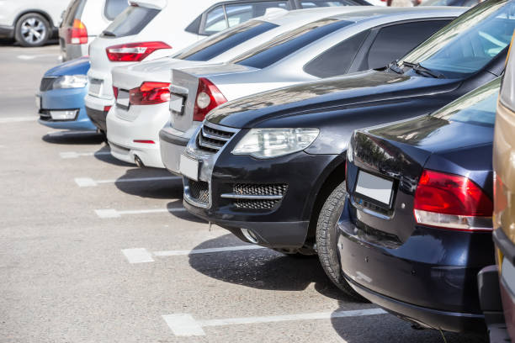
1. TECHNICAL FEASIBILITY:
To determine whether the proposed system is technically feasible, we should take into consideration the technical issues involved behind the system.
OnlineCarParkingReservationSystem uses the web technologies, which is rampantly employed these days worldwide. The world without the web is incomprehensible today. That goes to proposed system is technically feasible.

Slide 12
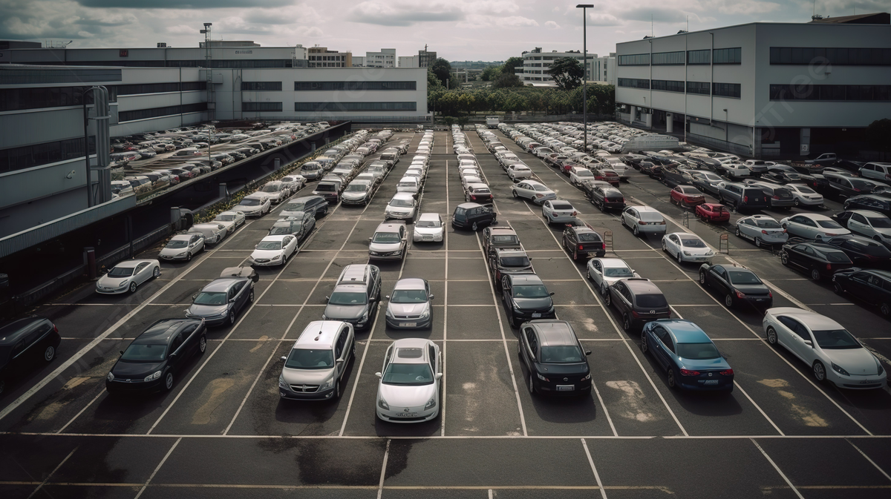
2. OPERATIONAL FEASIBILITY:
To determine the operational feasibility of the system we should take into consideration the awareness level of the users. This system is operational feasible since the users are familiar with the technologies and hence there is no need to gear up the personnel to use system. Also the system is very friendly and to use.

Slide 13
3. ECONOMIC FEASIBILITY:
To decide whether a project is economically feasible, we have to consider various factors as:
Cost benefit analysis
Long-term returns
Maintenance costs
The proposed OnlineCarParkingReservationSystem is computer based. It requires average computing capabilities and access to internet, which are very basic requirements and can be afforded by any organization hence it doesn’t incur additional economic overheads, which renders the system economically feasible.

Slide 14
Software and Hardware specifications
Software Requirements:
Technology : Java 2 Standard Edition, JDBC
Web Server : Tomcat 7.0
Client Side Technologies : HTML, CSS, JavaScript
Server Side Technologies : Servlets, JSP
Data Base Server : MySQL
Editor : Eclipse
Operating System : Microsoft Windows, Linux or
Mac any version
Hardware Requirements
Processor : Pentium-IV
Monitor : SVGA Color monitor
Ram : 1GB
Hard disk : 40GB

Slide 15
Class diagram:

Slide 16
Object diagram:

Slide 17
State diagram:

Slide 18
Test cases:
1. Test case for Login form:
FUNCTION: | LOGIN
EXPECTED RESULTS: | Should Validate the user and check his existence in database
ACTUAL RESULTS: | Validate the user and checking the user against the database
LOW PRIORITY | No
HIGH PRIORITY | Yes

Slide 19
2. Test case for User Registration form:
FUNCTION: | USER REGISTRATION
EXPECTED RESULTS: | Should check if all the fields are filled by the user and saving the user to database.
ACTUAL RESULTS: | Checking whether all the fields are field by user or not through validations and saving user.
LOW PRIORITY | No
HIGH PRIORITY | Yes

Slide 20
3. Test case for Change Password:
When the old password does not match with the new password ,then this results in displaying an error message as “ OLD PASSWORD DOES NOT MATCH WITH THE NEW PASSWORD”.

Slide 21
4. Test case for Forget Password:
Module | Functionality | Test Case | Expected Results | Actual Results | Result | Priority
User | Login Usecase | Navigate To Www.Sample.Com 2.Click On Submit Button Without Entering Username and Password | A Validation Should Be As Below “Please Enter Valid Username & Password” | A Validation Has Been Populated As Expected | Pass | High

Slide 22
Contd….
 |  | A Navigate To Www.Sample.Com 2. Click On Submit Button With Out Filling Password And With Valid Username | A Validation Should Be As Below “Please Enter Valid Password Or Password Field Can Not Be Empty “ | A Validation Is Shown As Expected | Pass | High
 |  | NNavigate To Www.Sample.Com Enter Both Username And Password Wrong And Hit Enter | A Validation Shown As Below “The Username Entered Is Wrong” | A Validation Is Shown As Expected | Pass | High

Slide 23
Contd…
 |  | Navigate To Www.Sample.Com Enter Validate Username And Password And Click On Submit | Validate Username And Password In Data Base And Once If They Correct Then Show The Main Page | Main Page/ Home Page Has Been Displayed | Pass | High

Slide 24
Output Screens

Slide 25
8.CONCLUSION AND FUTURE ENHANCEMENTS
CONCLUSION:
From this concept I conclude that these application will help many people from finding the empty space without any collision or minor accident. This application is easily accessible and easy to use. Hence this is the best alternative to Car Parking Management System.
FURTHER ENHANCEMENTS:
Based on the various parameters and properties files everything from the look and feel to the functionalities can be customized. Thus this project is developed from the beginning with reuse in mind and implicitly uses several design patterns.
The features provided by use for more interactive enhancement of the screens and inclusion of more data.

Slide 26


